Slide 1
Validation Controls
Chapter 7

Slide 2
What Are You Going To Learn?
At the end of this lesson, you will be able to:
Define validation controls.
Differentiate different types of validation controls.
Apply six types of validation controls.
Set other available properties.

Slide 3
What is validation control?
Validation server control is used to validate the data of an input control.
If the data does not pass validation, it will display an error message to the user.
Each validator is associated with a single input control, but you can associate two or more validators with the same input control.

Slide 4
Process validation
Validation tests are typically done on the client before the page is posted to the server. Why?
Validation is always done on the server too. Why?

Slide 5
Six types of validation controls
RequiredFieldValidator
Ensures that a field is not left empty
CompareValidator
Compares the entered text with a value or with another control
Check data type
RangeValidator
Ensures the entered text is within a specified range

Slide 6
Six types of validation controls
RegularExpression Validator
Matches the entered text against a specified pattern
CustomValidator
Runs custom code to validate the entered text
ValidationSummary
Provides a place to summarize error messages

Slide 7
Common validator properties
ControlToValidate
The ID of the control to be validated.
Display
Determine how the error message is to be displayed.
ErrorMessage
The message that’s displayed in the validator and/or the ValidationSummary control when the validation fails.
Text
The message that’s displayed in the validator.
Value = none, static or dynamic.
Notes:
Display – static (default): the location of the validation control is fixed; dynamic: the location will be placed directly next to the control to validate

Slide 8
Common validator properties
Enabled
Indicates whether the validation control is enabled.
EnableClientScript
Indicates whether the validation will be done on the client.
ValidationGroup
Indicates which group the validation is part of.
IsValid
Indicates whether the control passed the validation.

Slide 9
Properties of ValidationSummary
DisplayMode
Specifies how the error messages from the validation controls are to be displayed.
HeaderText
The text that’s displayed before the list of error messages.
ShowSummary
A Boolean value that determines whether the validation summary should be displayed on the web page.

Slide 10
Properties of ValidationSummary
ShowMessageBox
A Boolean value that determines whether the validation summary should be displayed in a message box.

Slide 11
Validation Group
Validation controls can be grouped together, allowing you to perform validation against a selection of controls.
All controls with the same ValidationGroup are checked at the same time, which means that controls that are not part of that group are not checked.

Slide 12
Page.IsValid
Use the IsValid property to determine whether all the input passed the validation.

Slide 13
CausesValidation property
Determine whether validation should be done when a particular control is being clicked.
Default is true.

Slide 14
SetFocusOnError property
Determines whether client-side script gives the focus to the first control that generated an error.
Default if False.

Slide 15
EnableClientScript property
Gets or sets a setting that determines whether the control provides validation at the client.
The default is True.

Slide 16
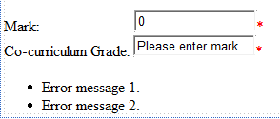
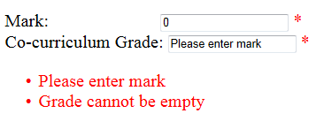
property of the RequiredFieldValidator
InitialValue
The initial value of the control that’s validated. If this value isn’t changed, the validation fails.
The default is an empty string.
ValidationSummary
<asp:RequiredFieldValidator ID=“rfvMark" runat="server"
ErrorMessage="Please enter mark" InitialValue="0"
ControlToValidate=“txtMark”>*</asp:RequiredFieldValidator>

Slide 17
properties of the CompareValidator
ValueToCompare
The value that the control specified in the ControlToValidate property should be compared to.
Operator
The type of comparison to perform.
Type
The data type to use for the comparison.
Value = String, Double, Integer, Date or Currency
value = Equal, NotEqual, LessThan, GreaterThan, LessThanEqual,GreaterThanEqual or DataTypeCheck

Slide 18
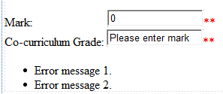
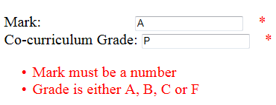
properties of the CompareValidator
ControlToCompare
The ID of the control that the value of the control specified in the ControlToValidate property should be compared to.
<asp:CompareValidator ID=“cvMark" runat="server"
ErrorMessage=“Mark must be a number“ Operator=“DataTypeCheck”
Type = “Double”
ControlToValidate=“txtMark”>*</asp:RequiredFieldValidator>

Slide 19

Questions
txtPassword1
txtPassword2
Assume that the above is part of a Change Password page. Suggest:
TWO different validations that should be done.
Demonstrate the code on how to validate whether 2 passwords are matched using the appropriate validation control in ASP.NET.

Slide 20
properties of the RangeValidator
MinimumValue
The minimum value allowed for the control.
MaximumValue
The maximum value allowed for the control.
Type
The data type to use for the comparison.

Slide 21

Example
Assume that the above is part of an Assessment page. Suggest:
TWO different validations that should be done for Mark field.
Demonstrate the code on how to validate the above using the appropriate validation control(s) in ASP.NET, so that the mark and grade must be within the given ranges.

Slide 22
Common regular expression elements
.
Ordinary character – Matches any character/string
\
Matches the character that follows.
\d
Matches any decimal digit (0-9).
\D
Matches any character other than a decimal digit.

Slide 23
Common regular expression elements
\W
Matches any character other than a word character.
\s
Matches any white space character (space, tab, new line, etc.).
\S
Matches any character other than a whitespace character.
\w
Matches any word character (a-z, A-Z, and 0-9).

Slide 24
Common regular expression elements
[^abcd]
Matches any character that is not included between the brackets.
[a-z]
Matches any characters in the indicated range.
{n}
Matches exactly n occurrences of the preceding element or group.
[abcd]
Matches any character included between the brackets.

Slide 25
Common regular expression elements
{n,m}
Matches at least n but no more than m occurrences of the preceding element or group.
*
Matches zero or more occurrences of the preceding element.
?
Matches zero or one occurrences of the preceding element.
{n,}
Matches at least n occurrences of the preceding element or group.

Slide 26
Common regular expression elements
+
Matches one or more occurrences of the preceding element.
|
Matches any of the elements separated by the vertical bar.
( )
Groups the elements that appear between the parentheses.

Slide 27
Metacharacter-+?*|
Examples:
[hc]+at matches "hat", "cat", "hhat", "chat", "hcat", "ccchat", and so on, but not "at".
[hc]?at matches "hat", "cat", and "at".
[hc]*at matches "hat", "cat", "hhat", "chat", "hcat", "ccchat", "at", and so on.
cat|dog matches "cat" or "dog".

Slide 28
Examples of regular expressions
(AB|SB)-\d{1,5}
The letters AB or SB, followed by hyphen and a one- to five-digit number. (e.g. SB-3276)
\d{5}(-\d{4})?
A five-digit number, optionally followed by a hyphen and a four-digit number. (93711-2765)

Slide 29
Examples of regular expressions
\w*\d\w*
A text entry that contains at least one numeral. (arm01)
[xyz]\d{3}
The letter x, y, or z, followed by a three-digit number. (x023)

Slide 30
Interpret the regular expressions below and provide examples of VALID input
\d{5}
\w{8, }
\d{3}-\d{7,8}
\w{1,8}\.[a-z]{3,4}
(WAD|WAB)\d{8}
Notes:
\d{5} – A five digit number. (53289)
\w{8,} – At least eight characters. (Frankenstein)
\d{3}-\d{7,8} – A three-digit number followed by a hyphen and a seven to eight digit number. (010-3944333)
\w{1,8}\.[a-z]{13,4} – Up to eight letters or numbers, followed by a period, and min 3 but up to four lower case alphabets(freddy.jpg)
(WAD|WAB)\d{8}-WAD or WAB, then followed by exactly 8 digits. (WAD20143211)

Slide 31
Example
<asp:RegularExpressionValidator ID="RegularExpressionValidator1" runat="server“ ControlToValidate=“txtPassword1"
ErrorMessage="Password length must be at least 7, with 1 non-alphanumeric character"
ValidationExpression=“ ">
</asp:RegularExpressionValidator>
Given the code for the RegularExpressionValidator above, complete the ValidationExpression value so that the password length must be at least 7, and one non-alphanumeric character at the end
Notes:
ValidationExperssion = “.{7,}[\W]+”
ValidationExpression = “.{7,}\W”

Slide 32
properties of the CustomValidator
ClientValidation Function
To specify the client-side validation function that should be called to perform the validation at client.
OnServerValidate
To specify the server side event handler that should be called when server side validation is performed.

Slide 33
Properties of the ServerValidateEventArgs Class
Value
the text string to be validated.
IsValid
A Boolean property that you set to True if the value passes the validation test or to False otherwise.

Slide 34
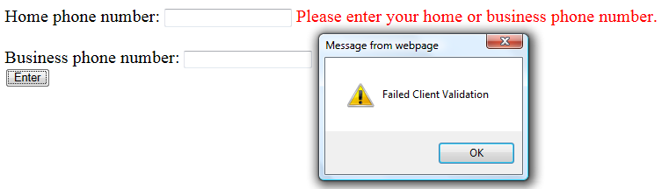
Example
Write a custom validation if you would like to customize your own validation. For example, require the user to enter at least home phone number or business phone number.

Slide 35
Sample Code (Sample.aspx)
<asp:CustomValidator ID="CustomValidator1" runat="server"
ErrorMessage= " enter home or business phone number." ClientValidationFunction=“ClientValidatePhoneNo" onservervalidate=“ServerValidatePhoneNo">
EnableClientScript="true"
</asp:CustomValidator>
Setting the value to “true” would invoke client script (JavaScript); value “false” for server code
Server code function
JavaScript function

Slide 36
Client Script Validation (Sample.aspx)
<script type="text/javascript">
function ClientValidatePhoneNo(source, args)
{
var txtHome = document.getElementById('<%= txtHome.ClientID %>');
var txtBusiness = document.getElementById('<%= txtBusiness.ClientID %>');
if (txtHome.value != " " || txtBusiness.value != " ")
{ window.alert("Passed client validation");
args.isValid = true; }
else
{ window.alert("Failed client validation");
args.IsValid = false;}
}
</script>

Slide 37
Server Validation (Sample.aspx.cs)
void ServerValidatePhoneNo(object source, ServerValidateEventArgs args)
{
if (txtHome.Text != string.Empty || txtBusiness.Text != string.Empty)
{
Response.Write(“Passed server validation");
args.IsValid = true;
}
else
{
Response.Write(“Failed server validatioin");
args.IsValid = false;
}
}

